Slide 1
Aligning Talent & Reward to Business Strategy
“The close collaboration and teamwork between NTT DATA Business Solutions and Mercury enabled us to deliver the HR project on time and within budget. The team’s responsiveness and reaction speed was an important factor, so a heartfelt thank you for your efforts on this project.”
Ann Garbutt
Global People Director, Mercury Engineering
Mercury Engineering
Why NTT DATA Business Solutions
Demonstrated a rapid and efficient implementation approach with it.talent management^{R2R}
A proven methodology that would de-risk the project
The ability of our consultants who demonstrated strong HR expertise and relevant industry knowledge
* itelligence AG operates as NTT DATA Business Solutions since April 1, 2021

Slide 2
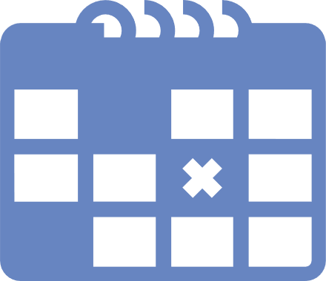
Mercury Engineering
Aligning Employee Compensation to Business Strategy
Product Deliveries Now Running Simply with SAP S/4HANA
Company
Solution
Key Facts
Company: Mercury Engineering
Industry: Construction
Services: Mercury is a European contractor that builds and manages complex engineering projects.
Number of employees: 1,700 worldwide (2019)
Turnover: £900m (2019)
Headquarters: Dublin, Ireland
Website: www.mercuryeng.com
SAP SuccessFactors Compensation Management, Performance & Goals, Succession and Career Development Planning
Multi-Country Roll-out
The solution has been rolled out to 13 countries in Europe including UKI
Challenges
The need to introduce an effective compensation rewards and recognition strategy and solution in a tight timescale
The need to create and link up the compensation process with business objectives
The requirement to gain deeper insights for key talent indicators such as performance and potential ratings and an overhaul of the salary planning process
The requirement for a digital solution to cater for the annual bonus pay, performance review and career planning
Go-Live
March 2020
Key Benefits
Reward & Recognition
A strategic compensation programme that improves individual and business performance
The solution has enabled the compensation team and managers to follow a standardised salary planning process that is based on best practices
Enabled robust processes for conducting performance and salary reviews. A simple digital process for awarding pay increases that is accessible anytime, anywhere
The Talent & Compensation team have centralised reporting with employees reviewed and rewarded in a consistent and transparent way
The solution supports 1700 users across 13 countries in Europe including UKI
Read more: [Link to Success Story Website]

Slide 3
3
Aligning Employee Compensation to Business Strategy
The close collaboration and teamwork between itelligence and Mercury enabled us to deliver the HR project on time and within budget. The itelligence team’s responsiveness and reaction speed was an important factor so a heartfelt thank you for your efforts on this project.”
Ann Garbutt
Global People Director
Mercury Engineering
Notes:
Reference Marketing Overview Template “Quote“ – Example.

